Slide 1


Titolo presentazione sottotitolo
Fare clic per modificare lo stile del titolo
Milano, XX mese 20XX
Fare clic per modificare lo stile del sottotitolo dello schema

Slide 2

Firma convenzione Politecnico di Milano e Veneranda Fabbrica del Duomo di Milano
Inserimento secondo logo
Fare clic per modificare lo stile del titolo
Fare clic per modificare lo stile del sottotitolo dello schema
Aula Magna – Rettorato
Mercoledì 27 maggio 2015

Slide 3
Requirement 2 - Pricing

Slide 4

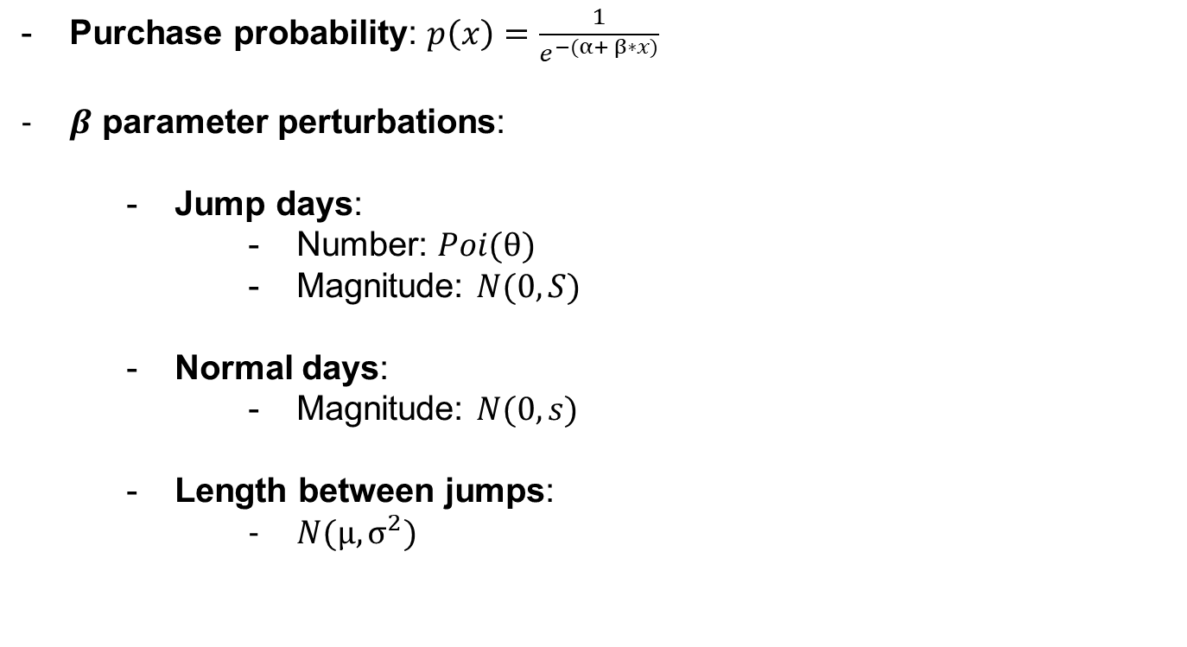
Environment
Purchase probability: $p\left(x\right)=\frac{1}{e^{−(α+ β∗x)}}$
$β$ parameter perturbations:
Jump days:
Number: $Poi(θ)$
Magnitude: $N(0, S)$
Normal days:
Magnitude: $N(0, s)$
Length between jumps:
$N(μ, σ^{2})$
Hyperparameters
- 1 Year, 4 Seasons:
- $θ$= 4
- $μ$= 90, $σ^{2}$= 30
- Probability consistent:
$α$= 1
$S$= 2
$s$= 0.01

Slide 5
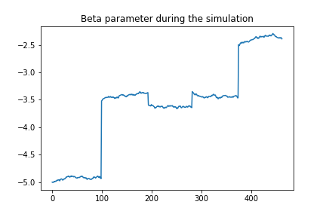
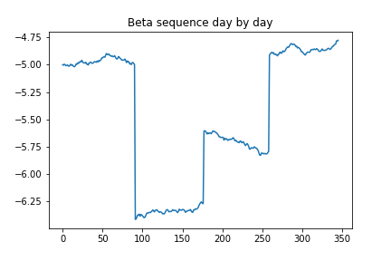
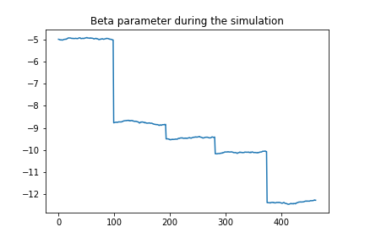
Environment
Here are some interesting situations that arose from the simulations. Moving clockwise, we can observe the cases of a successful, unsuccessful, and fluctuating product.

Slide 6
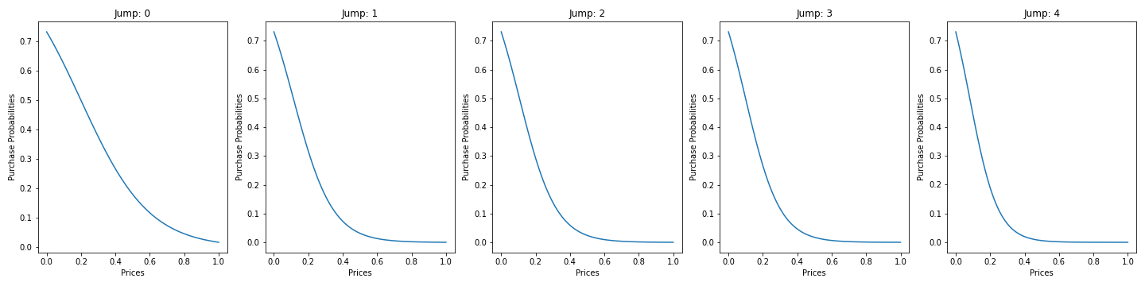
Environment – Unsuccessful Product
Focus on an unsuccessful product.
In the graphs below one can appreciate the purchase probability in correspondence of the jumps day.

Slide 7
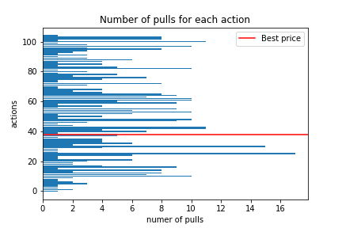
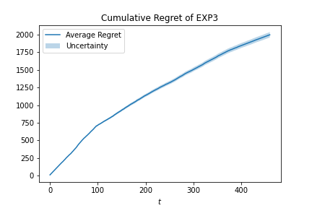
Agent: EXP3
EXP3 does not converge to a single arm, as it continuously explores to avoid being impacted by environmental changes. However, it tends to select arms that are close to the optimal one more frequently, resulting in a sublinear cumulative regret.

Slide 8
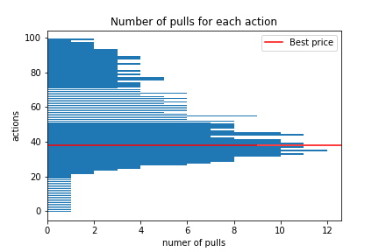
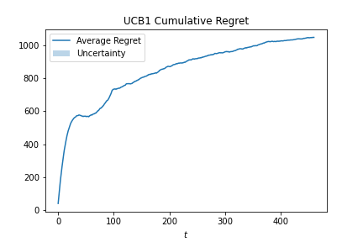
Agent: UCB1
UCB1 converges to the optimal arm, with its cumulative regret characterized by a first superlinear part , corresponding to the exploration phase followed by a sublinear one, relative to the exploitation phase, where it increasingly exploits the best arms.
Notice that the regret magnitude is half of the EXP3 one and the sublinear trend is more evident.

Slide 9
Requirement 2 - Advertising

Slide 10

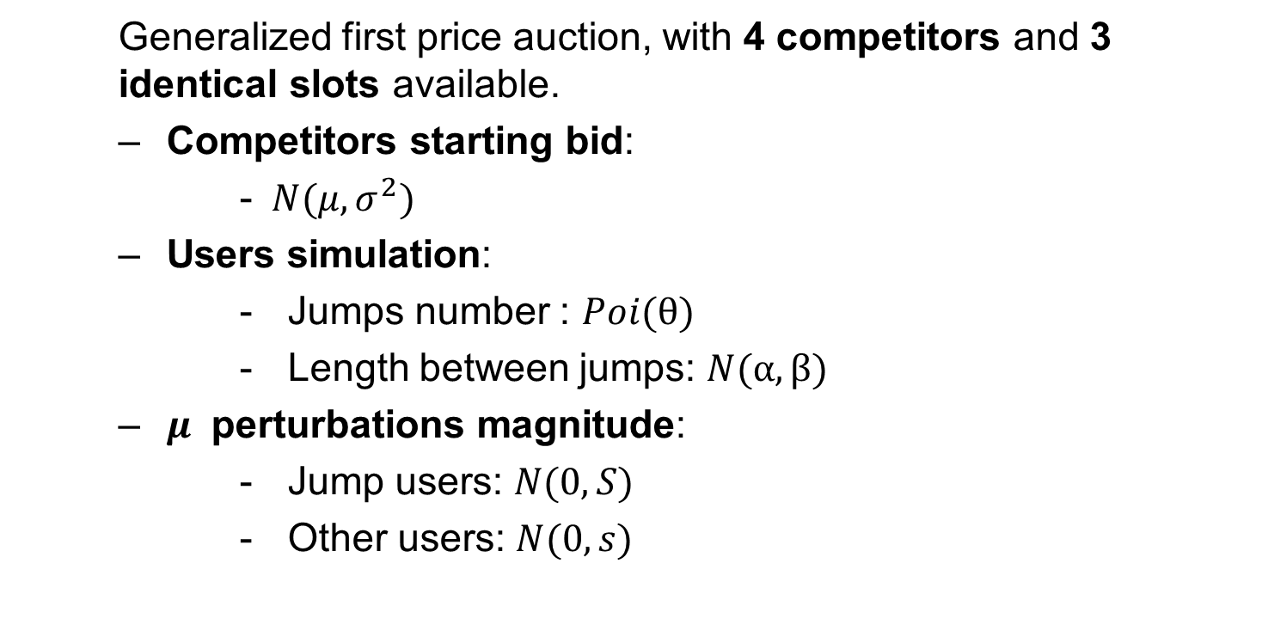
Environment
Generalized first price auction, with 4 competitors and 3 identical slots available.
Competitors starting bid:
- $N(μ, σ^{2})$
Users simulation:
Jumps number : $Poi(θ)$
Length between jumps: $N(α,β)$
$μ$ perturbations magnitude:
Jump users: $N(0, S)$
Other users: $N(0, s)$
Hyperparameters
- Competitors bids:
- $μ$ = 0.5
- $σ^{2}$ = 0.05
- 1 Day, 3 different phases:
- $θ$= 3
- $α$= ${10}^{4}$, $β$= ${10}^{2}$
- Perturbations:
- S = 0.1
- s = 0.001

Slide 11
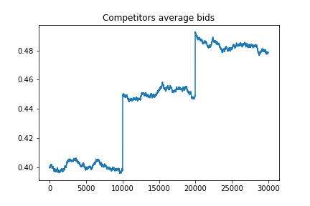
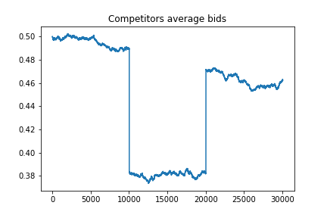
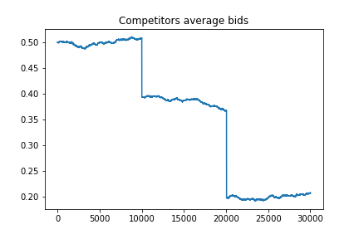
Environment
Here are some interesting situations that arose from the simulations. Moving clockwise, we can observe the case of a day in which the expected competitors bid is increasing, decreasing, and not monotonic.

Slide 12
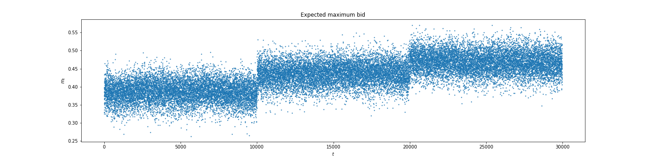
Environment – Competitors increasing bids
Focus on an day, where the competitors average bid increases.
In the graphs below one can appreciate the expected maximum bid and its changes during the simulation.

Slide 13
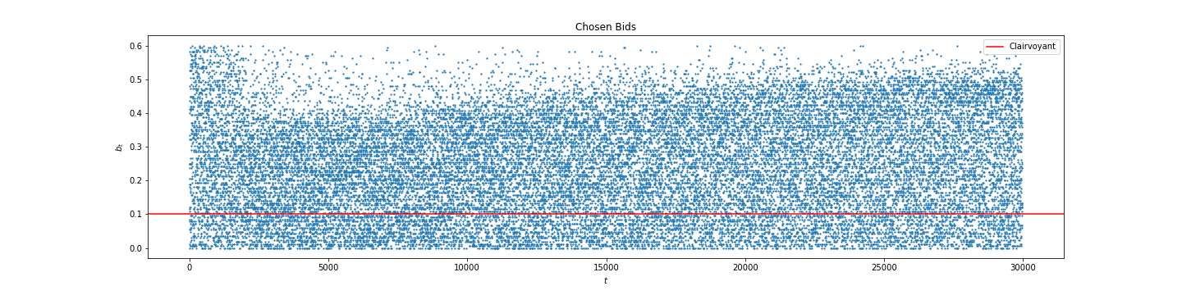
Agent: Full Feedback Multiplicative Pacing with Hedge Low Budget
Using a budget of approximately 1/5 of that of the competitors, the agent exhibits a more conservative behavior, heavily biased towards exploration. Although this exploration moves in the right direction, the exploitation process is significantly lacking. This is likely due to the low budget per round, which prevents the agent from adequately exploring higher bids.

Slide 14
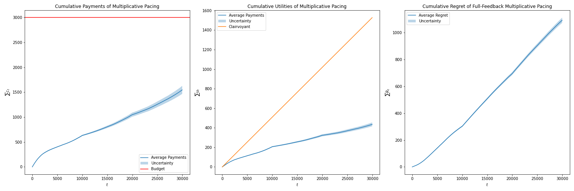
Agent: Full Feedback Multiplicative Pacing with Hedge Low Budget
It is important to note that, despite the low budget, the agent tends not to deplete it, distributing it throughout the entire simulation. Comparing the cumulative utility with that of the clairvoyant reveals the poor performance of our agent, as it only achieves sublinear cumulative utilities. Compared to the linear utility of the clairvoyant, this results in a cumulative regret that is linear or even superlinear.

Slide 15
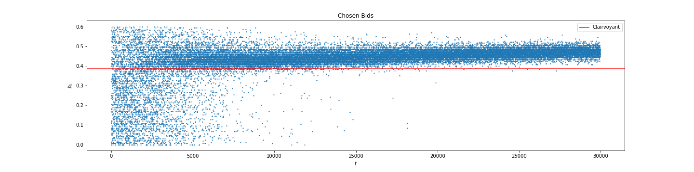
Agent: Full Feedback Multiplicative Pacing with Hedge Fair Budget
Assigning a budget similar to that of the competitors, our agent seems to achieve a good balance between exploration and exploitation phases. Notably, there is a predominant exploration phase at the beginning, after which the agent settles into a range of competitive bids with a slightly increasing trend, as much as possible. It is important to remember, indeed, that our agent’s valuation is 0.6, and at some point, the winning bids approach this value closely.

Slide 16
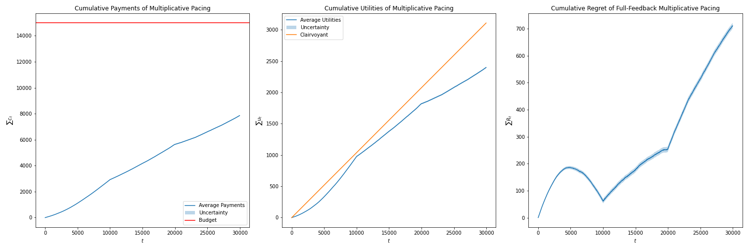
Agent: Full Feedback Multiplicative Pacing with Hedge Fair Budget
As in the previous case, the budget is not depleted. The cumulative utility is sublinear during the initial exploration phase (t < 5000), then becomes superlinear once the winning bid range is identified (5000 < t < 10000). Due to increasing jumps, the winning bid closely approaches the agent’s valuation, resulting in a linear trend (10000 < t < 20000) and eventually a sublinear trend (t > 20000). This behavior is also evident in the cumulative regret plot.

Slide 17
Requirement 2 - Interaction

Slide 18
Overview of Pricing and Advertising Strategy
We selected the most promising scenario from the pricing simulations, where the logistic function describing the purchase probability experiences decreasing perturbations.
Each day, the price is reassessed based on the number of customers brought in by the previous day's advertising campaign, combined with the purchase probability used
Pricing Agent: UCB1 is used to select the optimal price.
Advertising Agent: FFMultiplicative Pacing with Hedge is employed to optimize the advertising strategy

Slide 19
Daily Interaction Process
Each day, the UCB1 pricing agent selects a price.
The selected price is passed to the advertising agent, which subtracts the product cost to define its valuation.
The advertising agent uses this valuation to run the day's advertising campaign.
The outcome of the campaign, based on the number of auctions won, determines the new number of customers.
This customers number, along with the purchase probability determines the new rewards for each price.
The pricing agent uses these rewards to selects the new price.

Slide 20
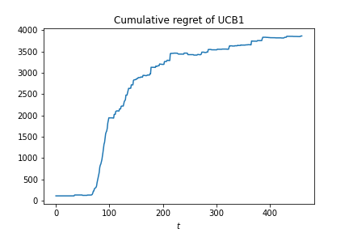
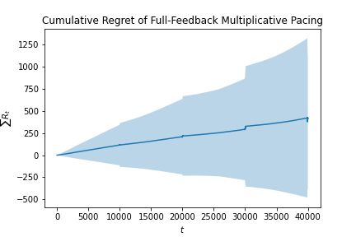
Results
Both algorithms achieve sublinear regret relative to their respective baselines, which are based on static policies. In the pricing part, the baseline is the optimal arm in terms of cumulative reward. For the advertising agent, the baseline is the best bid determined by a linear programming solution with budget constraints.

